Slide 1




Slide 2
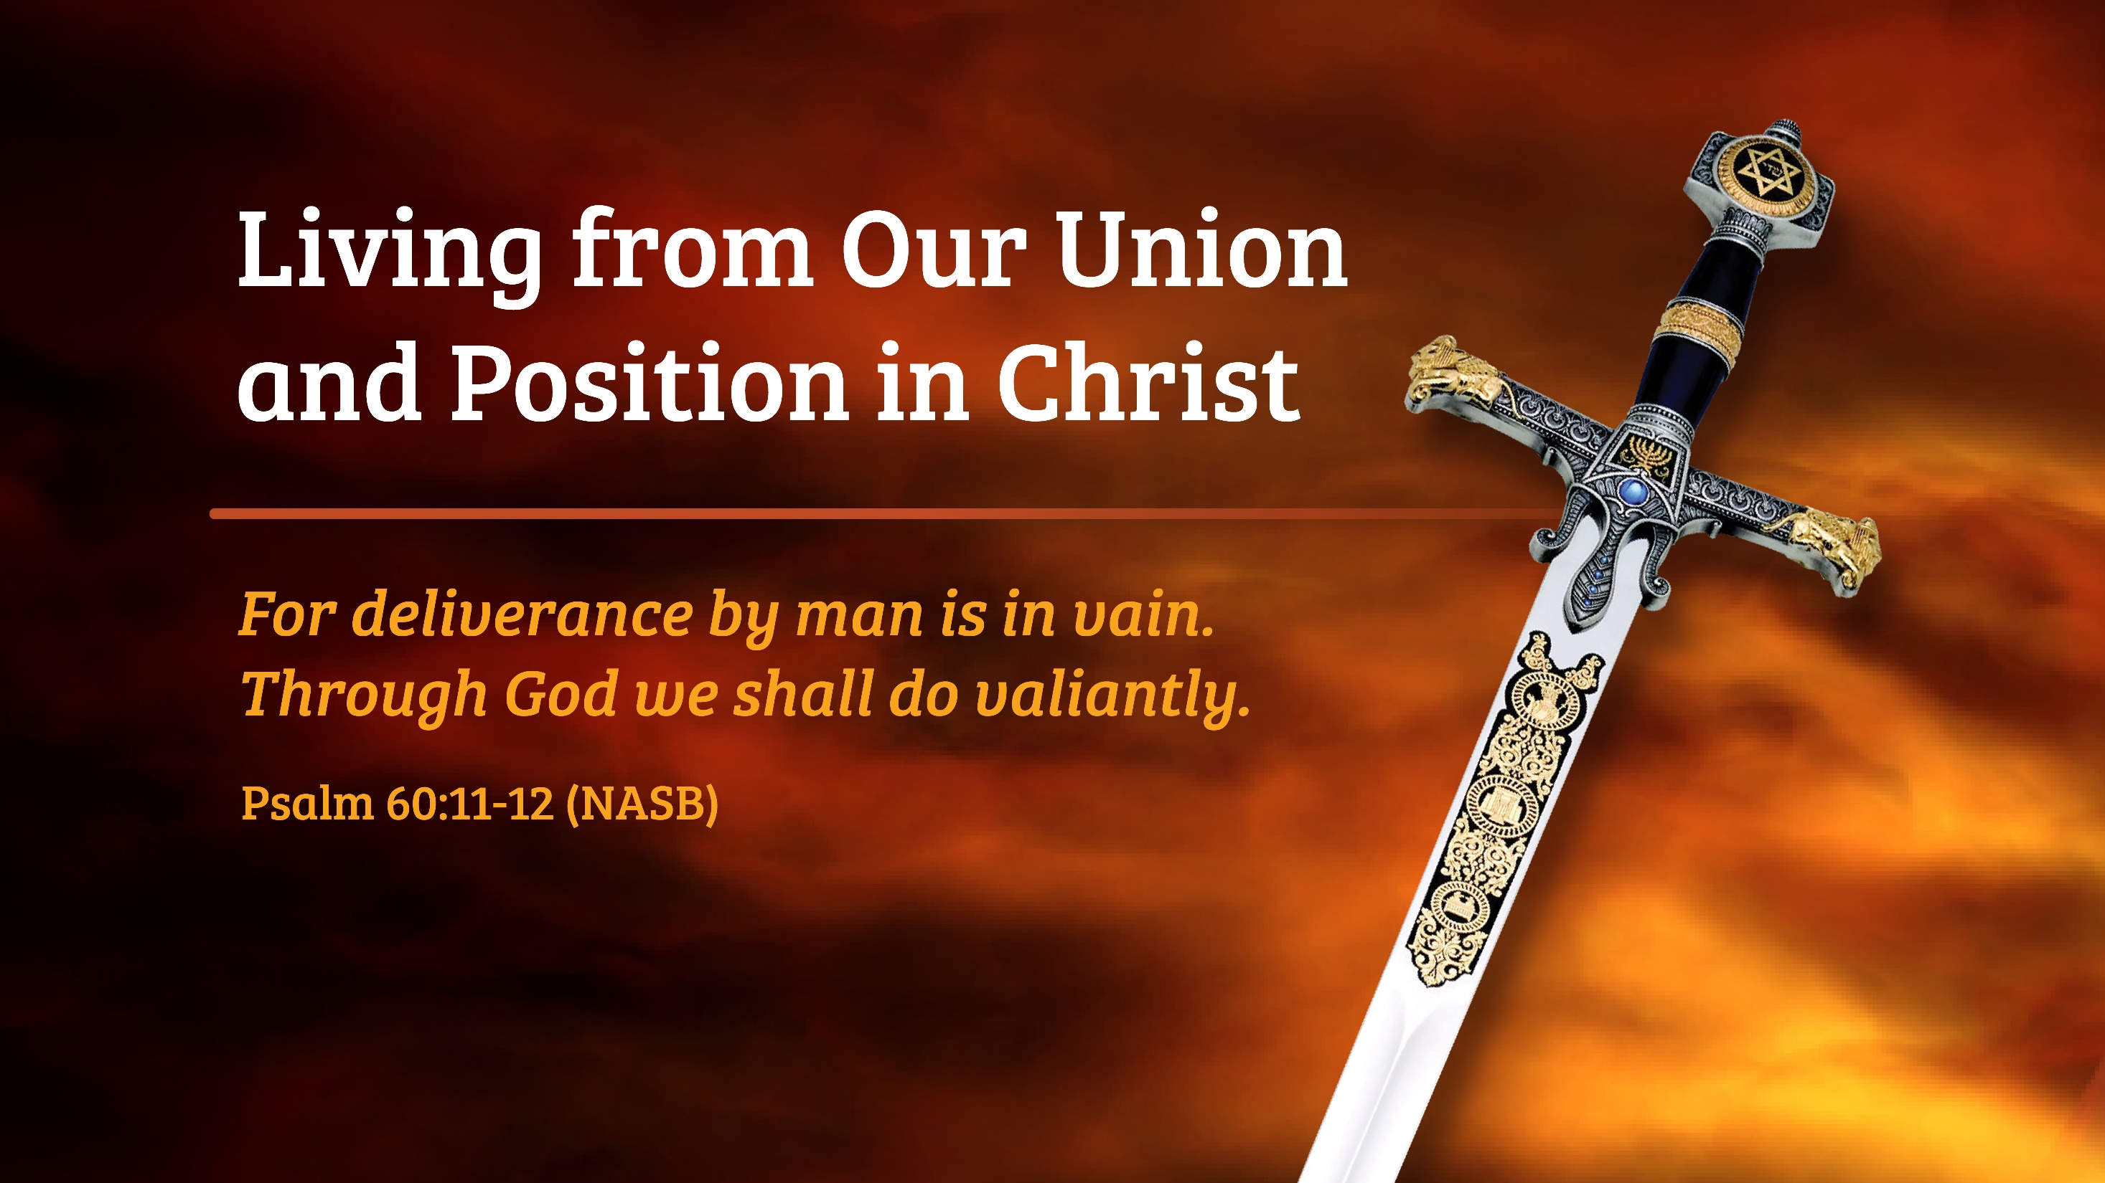

Slide 3
Introduction
This course is meant to be a help to those who have recognized the attacks of the enemy upon their lives and who have chosen to 'resist' him.
It has been referred to as a “Post-deliverance” course, however, it may also be helpful to those who have not yet experienced freedom in their lives.
(from page 4 of “Victorious Spiritual Warfare”)

Slide 4
The Battle
"There is no neutral ground in the universe; every square inch, every split second, is claimed by God and counterclaimed by Satan.”
C. S. Lewis, Christian Reflections, pg.33 (Eerdman’s Pub., 1967)

Slide 5
“The need today is for a company of overcoming saints who know how to wage war for the release of those under the enemy's deception. A Christian life is an unending engagement in the battlefield. The Christian has no possibility of laying down his arms until he stands before the Lord. To remove warfare from the Christian's life is to render it unfruitful. A spiritual life is one of spiritual usefulness because it is lived to mount assault upon assault against God's spiritual enemy. May God raise up such warriors!"
(Watchman Nee, The Spiritual Man. Vol. 3)

Slide 6
Re-introducing the Messiah
Key Truths about the Identity and Purpose of the Savior, Jesus Christ.

Slide 7
1. His Name
Jesus or Y’shuah –
The Hebrew form, corresponds to “Joshua”, meaning “God will deliver”, not specifically from sin, but from anything: “distress, war, servitude, or enemies”.
(Nelson’s Expository Dictionary of the Old Testament, Unger and White, 1980).

Slide 8
2. His Self-Introduction
“The spirit of the Lord is upon me, because He anointed me to announce the good news to the poor, He has sent me to heal the broken in heart, to proclaim to captives, ‘Deliverance!’ and to the blind recovery of sight; To send forth the crushed in freedom, to proclaim the acceptable year of the Lord.”
Luke 4:18, 19 (Berry’s Interlinear New Testament)

Slide 9
3. His Deeds
Approximately 1/3 of the account of His ministry as recorded in the Gospels was in direct spiritual confrontation with Satan or demons.

Slide 10
4. His Contrasting Approach
Toward us:
“Christ Jesus came into the world to save sinners.”
(1 Timothy 1:15)
Toward the Enemy:
“The Son of God appeared for this purpose, to destroy the works of the devil.” (1 John 3:8)

Slide 11
5. His Calling to His Disciples
“And having summoned His twelve disciples, He gave them authority over unclean spirits, to cast them out, …” (Matthew 10:1 – see also Luke 9:1)
“And He appointed twelve, that they might be with Him, and that He might send them out to preach, and to have authority to cast out the demons.” (Mark 3:14, 15)

Slide 12
6. His Stated Intent
“I will build my Church and the ‘presiding authorities’ (gates) of hell shall not prevail against it!” (Matthew 16:18)

Slide 13
7. His Delegation of the Mission
“All authority has been given to me in heaven and on earth. Going therefore, disciple all the nations, baptizing them into the name of the Father and of the Son and of the Holy Spirit; teaching them to observe all things whatsoever I commanded you.”
(Matthew 28:18-20 – Berry’s Interlinear New Testament)

Slide 14
How Believers are Linked to the Life and Mission of Jesus
"Remember the word that I said to you, 'A slave is not greater than his master.’ If they persecuted Me, they will also persecute you; if they kept My word, they will keep yours also.” (John 15:20)
"By this we know that we are in Him: The one who says he abides in Him ought himself to walk in the same manner as He walked.” (1 John 2:5-6)

Slide 15
Other Words to Believers
2 Corinthians 2:10, 11 No advantage to Satan – not ignorant…
2 Corinthians 10:3, 4 “We do not war according to the flesh…”
Galatians 4:8.9 We were slaves to “stoikia” or ‘ranks’
Ephesians 1:18-2:6 “…far above all rule and authority…” (us too!)
Ephesians 3:8-12 “…made known to rulers and authorities…”

Slide 16
Other Words to Believers
Ephesians 4:26, 27 “Do not give the devil an opportunity.”
Ephesians 6:10-20 “For our struggle is against rulers, powers…”
1 Timothy 4:1 “…and doctrines of demons,”
James 4:7 “Therefore submit to God and resist”
1 Peter 5:8, 9 “Your adversary, the devil, prowls – resist”

Slide 17
How We Got Here
Genesis 1:26 Genesis “Delegation” - Authority to Rule…over all the earth. (see Psalm 8:6)
Genesis 3:1 Authority lost by stepping out of God’s authority. No longer rulers of God’s creation, but slaves having “handed over” our dominion. (John 12:31, 14:30, 16:11, Luke 4:6)
(Note Romans 6:16, We are slaves to the one we obey.)
Genesis 6:5 The yeast of the lie does its work – (knowledge of good AND evil? Not any more…). An earth ruled by the destroyer was destroyed.

Slide 18

Genesis 4:7 “…you must master it”
Position in Christ…
Zechariah 4:7 RESTORATION FORETOLD
“What are you O great mountain? Before Zerubbabel you will become a plain…”
Spiritual Warfare
Genesis 1:26 Man—Created to rule over the earth
Genesis 3:1 “Serpent” … Whisperer
Genesis 3:1-4 First Spiritual Attach
Took what God had said and turned it around
“Experience the bad so you would know the good”
Satan stole the AUTHORITY God gave to man
Genesis 4:7 Cain warned by God (Sin “the offender” at the door)
Waiting for you
You must master it

Slide 19
Authority Restored
Restoration of man’s delegated rule had to come by a man, the “Son of Man”, Jesus Christ!
(1 Corinthians 15:21-28 and Romans 5:17)

Slide 20
Position in Christ…
Galatians 4:7
Key to our position in Christ
Ephesians 1 & 2 | John 1:2
Christ seated far above…
Spiritual Warfare
James 4:7
The “two step”
Galatians 4:4
Then when the FULLNESS OF TIME CAME…
1 John 3:8 - Jesus’ purpose: Destroy the work of the devil
Romans 8:14, 29 - Believers made Sons of God (Hulios)
Matthew 28
- All authority in heaven AND earth given
- Teaching to obey ALL I have commanded you
Haggai 1:4-7
- God’s desire to restore the worship center
- Signet Ring – Luke 15 – prodigal son

Slide 21
Victory –
It’s all about Where You are Sitting!
“But God, being rich in mercy, because of His great love with which He loved us, even when we were dead in our transgressions, made us alive together with Christ (by grace you have been saved), and raised us up with Him, and seated us with Him in the heavenly places in Christ Jesus…”
(Ephesians 2:3-6)

Slide 22
Our Position –
Not a Luxury, but a Necessity!
On the African plains of the Serengeti, the antelope is born able to run almost immediately – there is a reason for this…

Slide 23
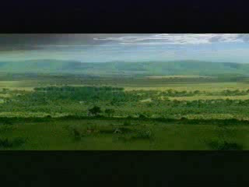

Slide 24
“Be of sober spirit, be on the alert. Your adversary, the devil, prowls around like a roaring lion, seeking someone to devour. But resist him, firm in your faith…” (1 Peter 5:8-9)
God’s gift of the ability to run, along with alertness, will give the antelope a longer, fruitful life.
God’s gift of our position of authority in Christ, along with alertness, will give us fruitful life and ministry.

Slide 25
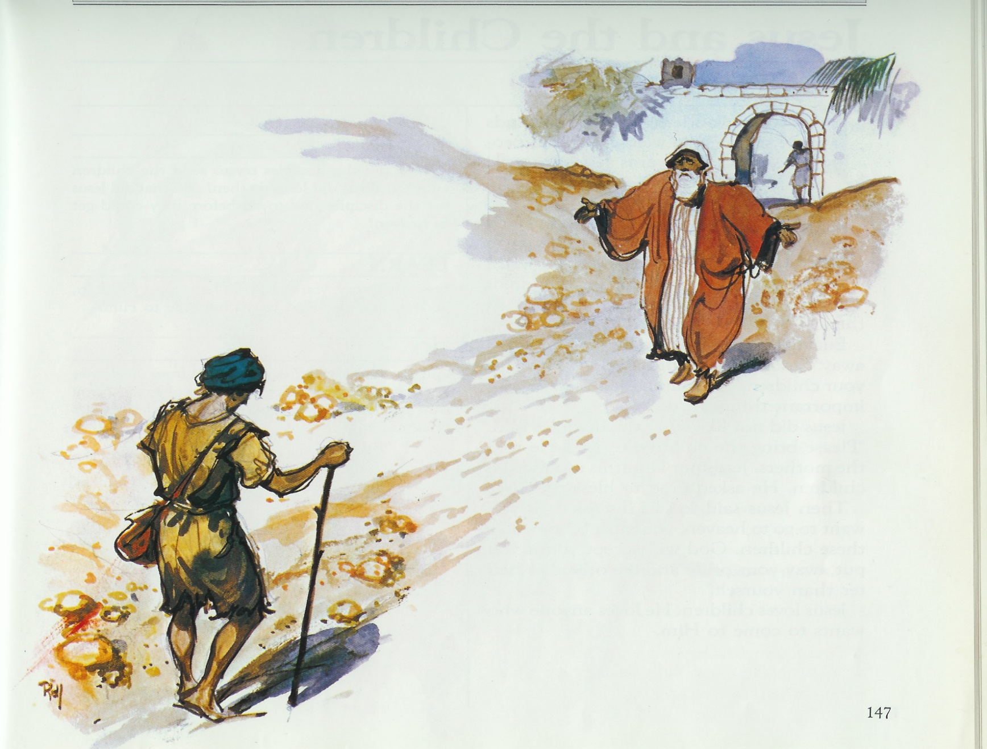
Our Problem with the Prodigal Son
Spiritual Warfare
Luke 15:11-22
He gets a ring.
We think the Father is crazy, but that’s grace.
He gets a robe, shoes and a ring.
Haggai 2:23

Slide 26
His Promise to Us is Clear
To the 70… “Behold, I have given you authority to tread upon serpents and scorpions, and over all the power of the enemy, and nothing shall injure you.” (Luke 10:19)
The Apostle John writes to the “children” of God, that we have “OVERCOME THEM” (the spirit of the antichrist).
Why?
“…because greater is He who is in you than he who is in the world!” (1 John 4:4)

Slide 27
NO FEAR
There is no place for fear when it comes to spiritual warfare and the believer…
“For God has not given us a spirit of fear, but of power, and love and a sound mind.”
(2 Timothy 1:7)
“Submit yourselves then, to God. Resist the devil, and he WILL flee from you.”
(James 4:7)

